Slide 1
Production of charmed hadron

Slide 2
1.Charm SPD & FF
2.Production of charmed meson
3. J/ψ production in Au+Au @200GeV
4.Two jets contribution
5.Apply SPD to calculate the di-hadron correlation of J/ψ on near and away sides

Slide 3

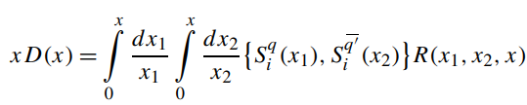




1.Charm SPD & FF
where
Parametrized SPD
Q=3GeV/c

Slide 4
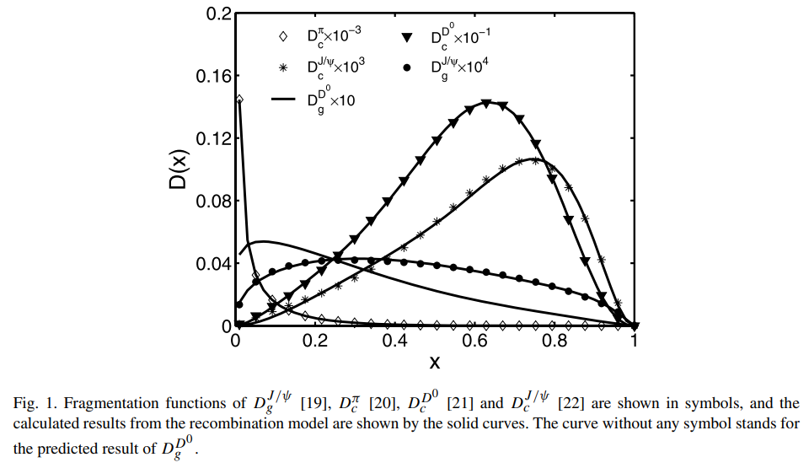
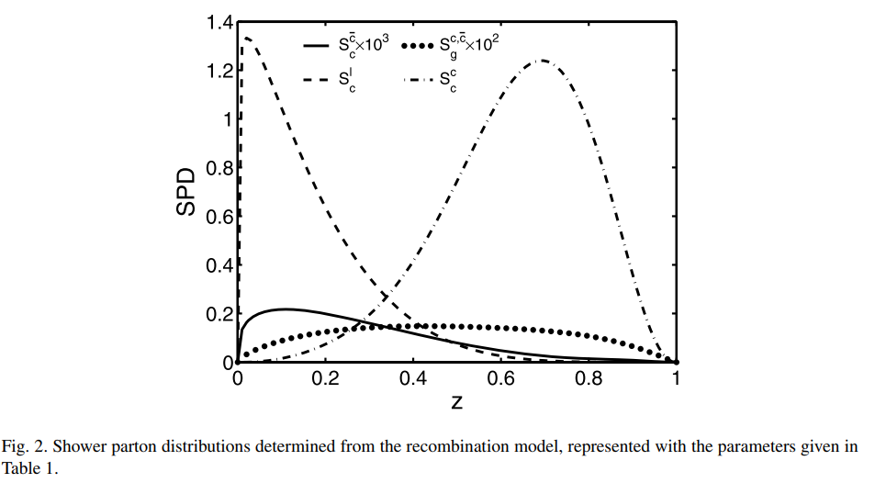
1.Charm SPD & FF

Slide 5


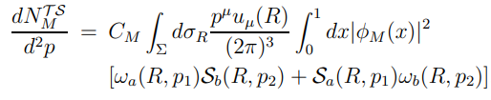

2.Production of charmed meson
Meson production
Q1:通过FF*RF得到？

Slide 6



2.Production of charmed meson
第一项
Wave function
2 fitted parameters

Slide 7





2.Production of charmed meson
第二项
Q2:formula of thermal？
SPD in central collision
Distribution from fi to Fi

Slide 8

2.Production of charmed meson
第三项

Slide 9





3.J/ψ production in Au+Au @200GeV

Slide 10
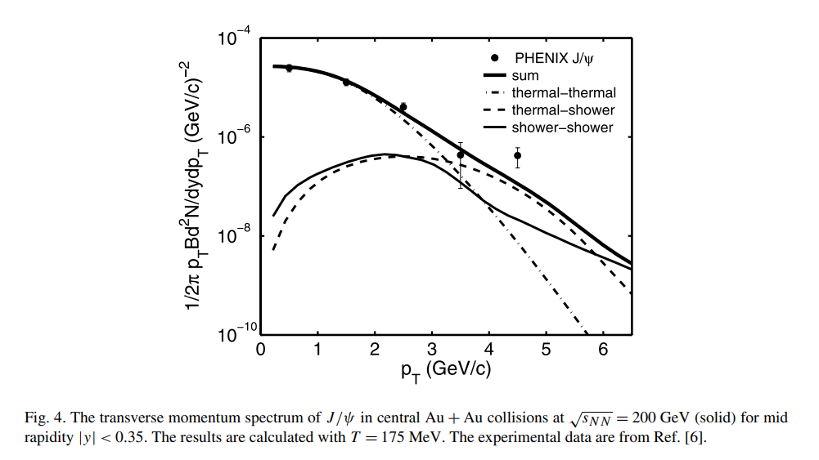
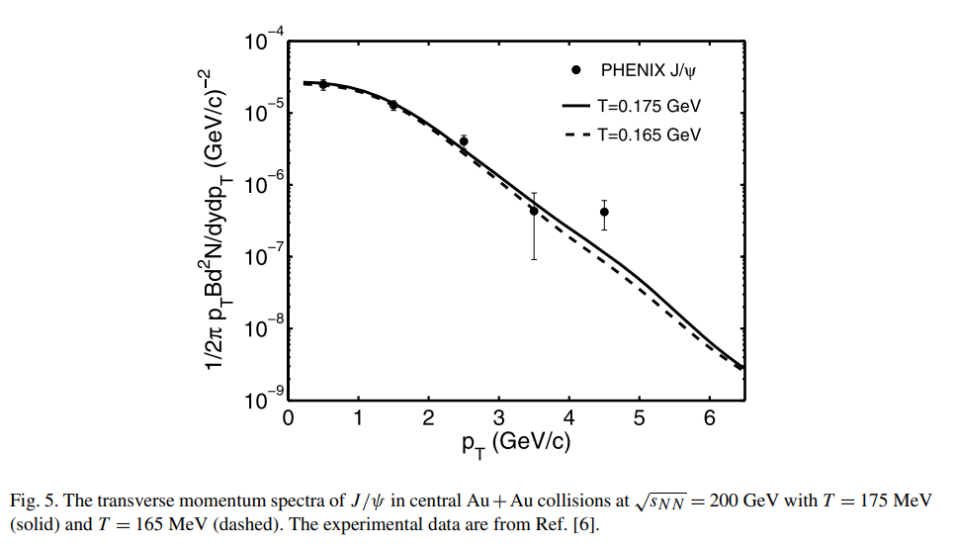
3.J/ψ production in Au+Au @200GeV

Slide 11
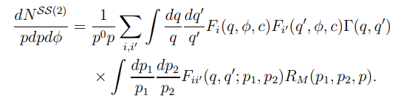



4.Two jets contribution
At higher energy or higher jet density, such as LHC, the contribution should be taken into account.
The overlap function between the two neighboring jets, reflects the probability for the overlap of the two shower partons, relating to .

Slide 12
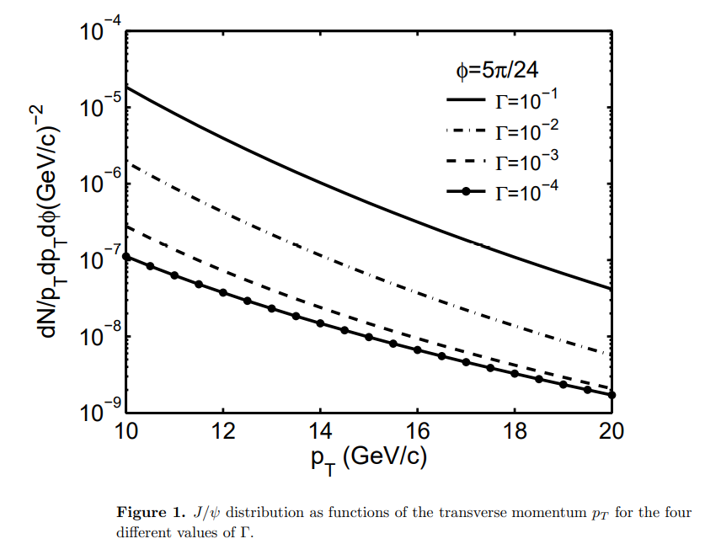
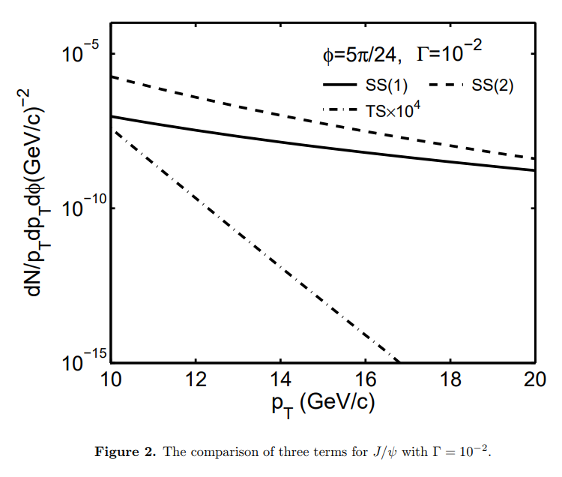
4.Two jets contribution

Slide 13
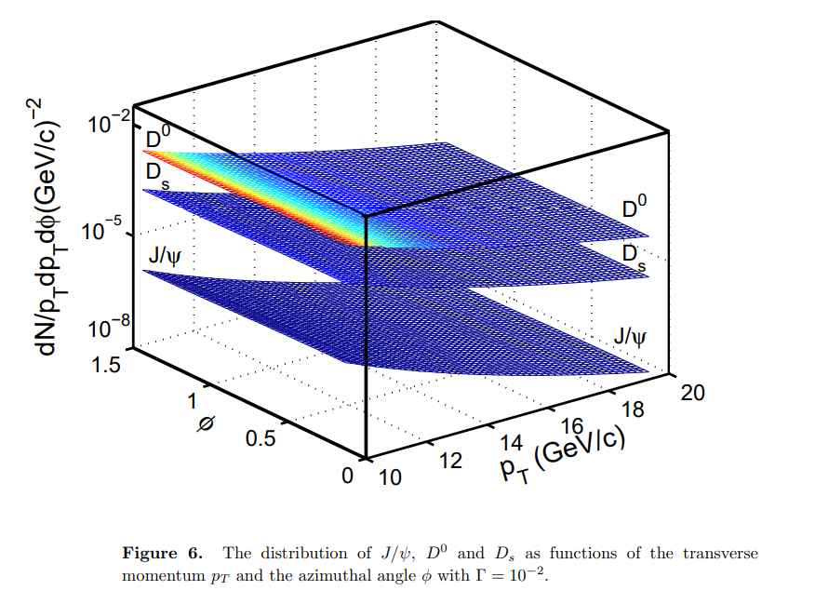
4.Two jets contribution

Slide 14
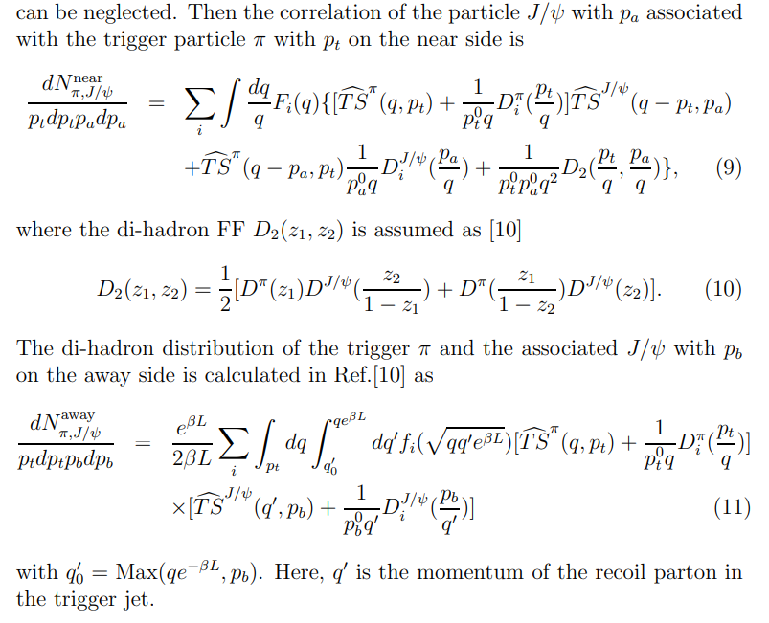
5.Apply SPD to calculate the di-hadron correlation of J/ψ on near and away sides
Q3: Trigger particle (pi) ? Associated particle (J/ψ) ?
Near side? Away side?

Slide 15
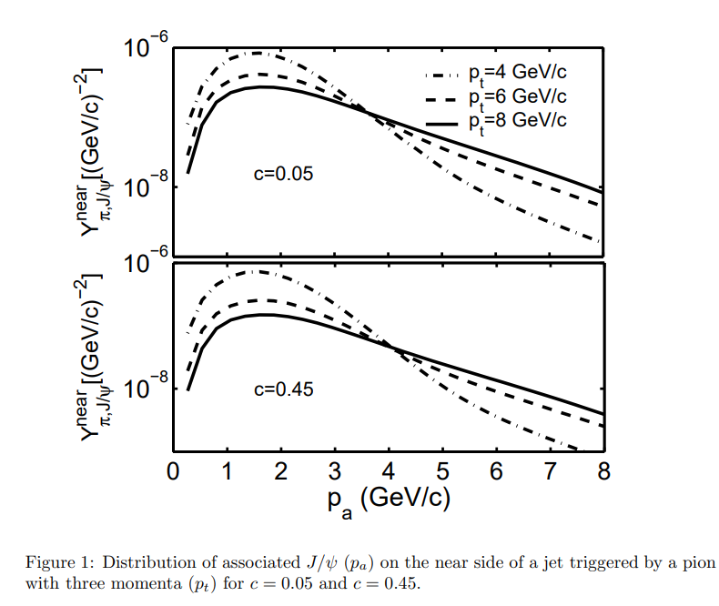

5.Apply SPD to calculate the di-hadron correlation of J/ψ on near and away sides
Q4: Yield function?

Slide 16

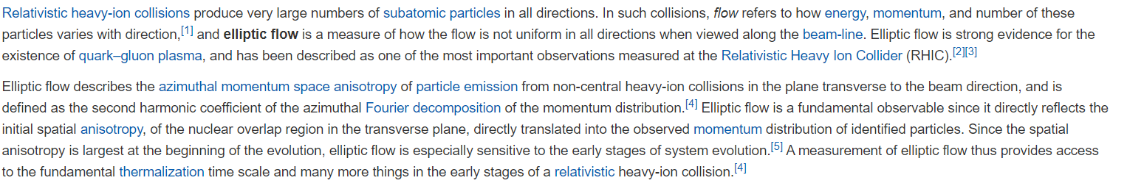
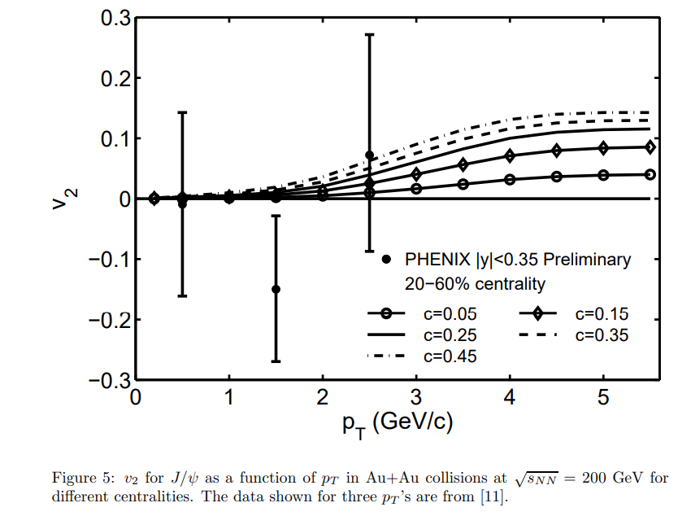
5.Apply SPD to calculate the di-hadron correlation of J/ψ on near and away sides
Elliptic flow v2 ?

Slide 17
References
[1] J/ψ production and elliptic flow parameter v2 at LHC energy.
[2] J/ψ production in Au + Au collisions at √sNN = 200 GeV in the recombination model.
[3] Productions of Heavy Flavored Mesons in Relativistic Heavy Ion Collisions in the Recombination Model.
[4] π-J/ψ Correlation and Elliptic Flow Parameter v2 of Charmed Mesons at RHIC Energy.
[5] Hadron production in heavy ion collisions: Fragmentation and recombination from a dense parton phase.

